Slide 1
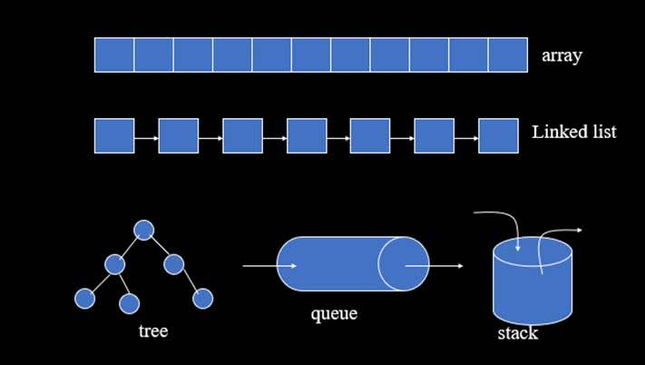
Chapter One
Introduction to Data structure and Algorithm Analysis

Slide 2
Introduction
Outline
Description of data structure
Description of algorithm analysis
Description of time complexity
Description of space complexity
Description of asymptotic notation

Slide 3

Introduction to Data Structures
What is data structure or how would you define data structure?
(Solution: In programming the term data structure refers to a scheme for organizing related piece of information. Example find shortest person??
Data Structure = Organized Data + Allowed Operations.)

Slide 4

Introduction to Data Structures
What is data structure?
Data is row fact(“Abebe”, “dagne”, “Nardos”, “21”)
Structure is suitable container (that store data item)
Therefore , data structure is the way of organized ,manipulated and store data in the computer memory location.

Slide 5
Introduction to Data Structures
There are two type of data structure
Primitive data structure, Example: Integer (int, double, float, short, long ,char, byte and Boolean)
Non primitive data structure divided into two:
Linear data structure: means data items are arranged in sequentially, Example: arrays, linked list, stack, queue
Non-linear data structure: means data are not arranged in sequentially, Example: Tree, graph

Slide 6
Use of Data Structure
What is the use of data structure?
It used to search data item easily
It used to delete data item easily
It used to insert data item easily
It used to create data item easily
It used to sort data item easily
It used to rename data item easily
Generally it used to manipulate data items in computer memory.

Slide 7
Application Areas of Data Structures
In what areas do data structures applied?
data structure is applied in the following areas:
Numerical analysis
Operating system
A.I
Compiler design
Database management
Graphics, and Statistical analysis.

Slide 8
What is program
What is program?
It is a set of instruction which is written in order to solve a problem.
A solution to a problem actually consists of two things:
A way to organize the data
Sequence of steps to solve the problem
Therefore, a program is Data structures plus Algorithm.
The quality of data structure and algorithms is determined by their ability to work together well.

Slide 9
What is Algorithm
What is Algorithm (Algo)?
It is a design part and uses any language(language independent)
A person who write algorithm is called domain knowledge and a person who write program is called programmer.
It is a step by step process to be followed to solve a given problems.
The sequence of computational steps to solve a problem is said to be an Algorithm and it perform specific tasks

Slide 10
Purpose of Algorithms
What is the purpose of algorithms in programs?
Take values as input:Example: cin>>age;
Change the values held by data structures: Example: age=age+1;
Change the organization of the data structure: Example: Sort students by name
Produce outputs: Example: Display student’s information
The quality of a data structure is related to its ability to successfully model the characteristics of the world (problem).
The quality of an algorithm is related to its ability to successfully simulate the changes in the world

Slide 11
Properties of Algorithm
What are the properties of algorithm?
Input /output: algorithm must take input(0 or more) and generate output.
Sequence: algorithm must flow steps or sequences.
Finiteness: algorithm must terminate or stop after a time.
Correctness: algorithm must generate a correct output/final result.
Definiteness(Unambiguous): algorithm statement must be clear and simple.
Effectiveness: effectively solve the given problem with small time unit.

Slide 12
Properties of Algorithm
What are the properties of algorithm?
Feasibility: It must be possible to perform each instruction. Each instruction should have possibility to be executed. Example : if(5>7)
{ cout<<“Dagne”;}
Language Independence: It must not depend on any one programming language.
Completeness: It must solve the problem completely
Efficiency: It must solve with the least amount of computational resources such as time and space
Generality: Algorithm should be valid on all possible inputs.

Slide 13
Abstract Model
What is abstract view or model?
The first step to solve the problem is obtaining ones own abstract view, or model, of the problem.
This process of modeling is called abstraction.
The model defines an abstract view to the problem.
The model should only focus on problem related stuff.
Example: model students of HU. Relevant: Char Name[15];
Char ID[11];Char Dept[20];int Age, year;
Non relevant: float height, weight;

Slide 14
Abstract Data Types(ADT)
What is Abstract Data Types(ADT)?
Abstract Data Types Consists of data to be stored and operations supported on them.
Abstract Data Types is a specification that describes a data set and the operation on that data.
Example: ADT employees of an organization:
Relevant Information:- Name, ID, Sex, Age, Salary, Dept, Address and Non Relevant :- weight, color, height
This ADT supports hiring, firing, retiring, … operations.

Slide 15
Algorithm analysis
What is algorithm analysis?
The process that determining how much resource the algorithm will required.
Algorithm analysis refers to the process of determining how much computing time/running time and storage/memory space that algorithms will require.
In other words, it’s a process of predicting the resource requirement of algorithms in a given environment.

Slide 16
Algorithm analysis
Algorithm analysis based on The following main resources :
Running Time
Memory Usage
Communication Bandwidth
Note: Running time is the most important to select the best algorithm when we need to compare algorithms.
There are two approaches to measure the efficiency of algorithms:
Empirical
Theoretical

Slide 17
Empirical Algorithm Analysis
What is Empirical(Computational) Algorithm Analysis?
it works based on the total running time of the program. It uses actual system clock time.
Example: t1(Initial time before the program starts)
for(int i=0; i<=10; i++)
cout<<i;
t2 (final time after the execution of the program is finished)
Running time taken by the above algorithm (TotalTime) = t2-t1;

Slide 18
Empirical Algorithm Analysis
Empirical (Computational): It is difficult to determine efficiency of algorithms using this approach.
because clock-time can vary based on many factors.
Processor speed of the computer: 1.78GHz ==> 10s
2.12GHz ==> 15s.
Current processor load: Only the work 10s, With printing 15s , browsing the internet >15s.
Data specification : Input size and Input properties.
Operating System: Multitasking Vs Single tasking

Slide 19
Theoretical Algorithm Analysis
What is theoretical Algorithm Analysis?
Determining the quantity of resources required using mathematical concept.
Analyze an algorithm according to the number of basic operations (time units) required, rather than according to an absolute amount of time involved.

Slide 20
Theoretical Algorithm Analysis
We use theoretical approach to determine the efficiency of algorithm because:
The number of operation will not vary under different conditions.
it helps us to have a meaningful measure that permits comparison of algorithms independent of operating platform.
It helps to determine the complexity of algorithm.

Slide 21
Theoretical Algorithm Analysis
Complexity Analysis is the systematic study of the cost of computation, measured either in:
Time units
Operations performed, or
The amount of storage space required.
Two important ways to characterize the effectiveness of an algorithm are its Space Complexity and Time Complexity.

Slide 22
Theoretical Algorithm Analysis
Time Complexity: Determine the approximate amount of time (number of operations) required to solve a problem of size n. The limiting behavior of time complexity as size increases is called the Asymptotic Time Complexity.
Space Complexity: Determine the approximate memory required to solve a problem of size n. The limiting behavior of space complexity as size increases is called the Asymptotic Space Complexity.
Asymptotic Complexity of an algorithm determines the size of problems that can be solved by the algorithm.

Slide 23
Theoretical Algorithm Analysis
Complexity analysis involves two distinct phases:
• Algorithm Analysis
• Order of Magnitude Analysis
Algorithm Analysis: Analysis of the algorithm or data structure to produce a function T(n) that describes the algorithm in terms of the operations performed in order to measure the complexity of the algorithm.
Order of Magnitude Analysis: Analysis of the function T (n) to determine the general complexity category to which it belongs.
There is no generally accepted set of rules for algorithm analysis. However, an exact count of operations is commonly used. To count the number of operations we can use the following Analysis Rule.

Slide 24
Time Complexity
Analysis rule (for calculate running time of a given program)
Execution of one of the following operations takes 1 time unit:
Assignment Operation : Eg. Sum=0,in x=s, string s=“Addis”;
Single Input/output Operation : E.g. cin>>sum; cout<<sum;
Single Boolean Operations: E.g. 5>2,true&&false
Single Arithmetic Operations: E.g. a+b , a-b, a*b ,a/b ,a%b
Function Return: E.g. return x , return 0;
Function call: E.g. add();

Slide 25
Time Complexity
We assume an arbitrary time unit.
Running time of a selection statement: (if, switch) is the time for the condition evaluation + the maximum of the running times for the individual clauses inside the selection.
Running time of a function call: is 1 for setup + the time for any parameter calculations + the time required for the execution of the function body

Slide 26
Time Complexity
Loop statements:: The running time for the statements inside the loop * number of iterations + time for setup(1) + time for checking (number of iteration + 1) + time for update (number of iteration). The total running time of statements inside a group of nested loops is the running time of the statements * the product of the sizes of all the loops.

Slide 27
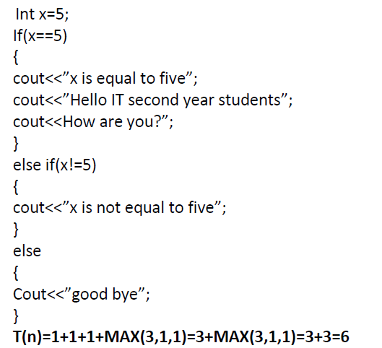
Time Complexity
Example 1:

Slide 28
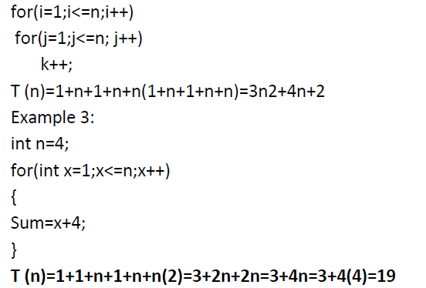
Time Complexity
Example 2:

Slide 29
Time Complexity
Example 4:
int k=0,n;
cout<<“Enter an integer”;
cin>>n;
for(int i=0;i<n; i++)
k++;
T(n)= 3+1+n+1+n+n=3n+5

Slide 30
Time Complexity
Example 6:
int i=0;
while(i<n)
{
cout<<i; i++;
}
int j=1;
while(j<=10)
{
cout<<j; j++;
}
T(n)=1+n+1+n+n+1+11+2(10) = 3n+34 =O(n)

Slide 31
Time Complexity
Example 7:
int k=0;
for(int i=1 ; i<=n; i++)
for( int j=1; j<=n; j++)
k++;
T(n)=1+1+(n+1)+n+n(1+(n+1)+n+n) = 2n+3+n(3n+2) = 2n+3+3n²+2n = 3n²+4n+3 = O(n²).

Slide 32
Time Complexity
Example 8:
int sum=0;
for(i=1;i<=n;i++))
sum=sum+i;
T(n)=1+1+(n+1)+n+(1+1)n =3+4n=O(n)
Example 9:
int sum(int n)
{
int s=0;
for(int i=1;i<=n;i++)
s=s+(i*i*i*i);
return s;
}T(n)=1+(1+n+1+n+5n)+1 =7n+4=O(n)

Slide 33
Time Complexity
Example 10:
int counter()
{
int a=0;
cout<<”Enter a number”;
cin>>n;
for(i=0;i<n;i++)
a=a+1;
return 0;
}
T(n)=1+1+1+(1+n+1+n)+2n+1 =4n+6=O(n)

Slide 34
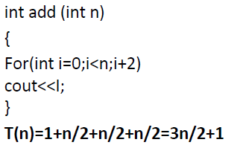
Time Complexity
Example 11: Example 12:
int x=0;
int i=0;
int j=1;
cout<<”Enter a number”;
cin>>n;
while(i<n){ i=i+1;
}
while(j<n)
{
j=j+1;
}
}T(n)=1+1+1+1+1+n+1+2n+n+2(n-1) = 6+4n+2n-2 =4+6n=O(n)

Slide 35
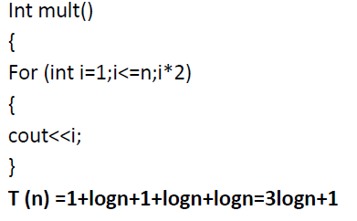
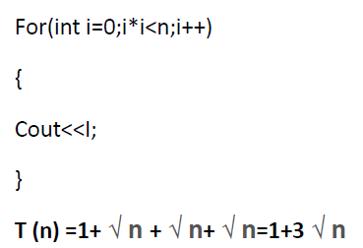
Time Complexity
Example 13:
int sum=0;
for(i=0;i<n;i++)
for(j=0;j<n;j++)
sum++;
T(n)=1+1+(n+1)+n+n*(1+(n+1)+n+n) =3+2n+n²+2n+2n² =3+2n+3n²+2n =3n²+4n+3=O(n²)
Example 14: Example 15:

Slide 36
Formal Approach to Analysis
In the above examples we have seen that analyzing Loop statements is so complex.
It can be simplified by using some formal approach in which case we can ignore initializations, loop controls, and updates.
Simple Loops: Formally, for loop can be translated to a summation.

Slide 37

Formal Approach to Analysis
In general, a for loop translates to a summation.
The index and bounds of the summation are the same as the index and bounds of the for loop.
for (int i = 1; i <= N; i++) {
sum = sum+i; }

Slide 38

Formal Approach to Analysis
Suppose we count the number of operations that are done.There is 2 operation per iteration of the loop 1 for assignment and 1 for addition , hence 2N in total.
Nested for loops translate into multiple summations, one for each for loop.
for (int i = 1; i <= N; i++) {
for (int j = 1; j <= M; j++) {
sum = sum+i+j;}}

Slide 39

Formal Approach to Analysis
Successive Statements: Formally add the running times of the separate blocks of your code
for (int i = 1; i <= N; i++) {
sum = sum+i;}
for (int i = 1; i <= N; i++) {
for (int j = 1; j <= N; j++) {
sum = sum+i+j;}}

Slide 40

Formal Approach to Analysis
If (test) s1 else s2: Compute the maximum of the running time for s1 and s2.
if (test == 1) {
for (int i = 1; i <= N; i++) {
sum = sum+i;}}
else for (int i = 1; i <= N; i++) {
for (int j = 1; j <= N; j++) {
sum = sum+i+j; }}

Slide 41
Categories of Algorithm Analysis
Worst case time complexity: - if the algorithm takes the largest amount of time, we call it worst case.
Best case time complexity: - if the algorithm takes the smallest amount of time, we call it best case.
Average case time complexity:- if the algorithm takes the average amount of time, we call it average case.

Slide 42
Best Case Analysis
Algorithms may be examined under different situations to correctly determine their efficiency for accurate comparison.
Best Case Analysis: Best case analysis assumes the input data are arranged in the most advantageous order for the algorithm.
It also takes the smallest possible set of inputs and causes execution of the fewest number of statements.
It computes the lower bound of T(n), where T(n) is the complexity function.

Slide 43
Best Case Analysis
Examples:
For sorting algorithm, If the list is already sorted (data are arranged in the required order).
For searching algorithm, If the desired item is located at first accessed position.

Slide 44
Worst Case Analysis:
Worst Case Analysis: Worst case analysis assumes the input data are arranged in the most disadvantageous order for the algorithm.
Takes the worst possible set of inputs.
Causes execution of the largest number of statements.
Computes the upper bound of T(n) where T(n) is the complexity function
Worst case analysis is the most common analysis because, it provides the upper bound for all input (even for bad ones).

Slide 45
Worst Case Analysis:
Example:
For sorting algorithms, If the list is in opposite order.
For searching algorithms, If the desired item is located at the last position or is missing.

Slide 46
Average Case Analysis
Average case analysis is often difficult to determine and define. If situations are in their best case, no need to develop algorithms because data arrangements are in the best situation.
Best case analysis can not be used to estimate complexity.
We are interested in the worst case time since it provides a bound for all input-this is called the “Big-Oh” estimate.
Average Case Analysis: Determine the average of the running time overall permutation of input data.

Slide 47
Average Case Analysis
Takes an average set of inputs.
It also assumes random input size.
It causes average number of executions.
Computes the optimal bound of T(n) where T(n) is the complexity function.
Sometimes average cases are as bad as worst cases and as good as best cases.

Slide 48
Average Case Analysis
Examples:
For sorting algorithms, While sorting, considering any arrangement (order of input data).
For searching algorithms While searching, if the desired item is located at any location or is missing.

Slide 49
Order of Magnitude
Order of Magnitude refers to the rate at which the storage or time grows as a function of problem size.
It is expressed in terms of its relationship to some known functions.
This type of analysis is called Asymptotic analysis.
Asymptotic Notations: Asymptotic Analysis is concerned with how the running time of an algorithm increases with the size of the input in the limit, as the size of the input increases without bound!

Slide 50
Order of Magnitude
Asymptotic Analysis makes use of O (Big-Oh) , Ω (Big-Omega), θ (Theta), o (little-o), ω (little-omega) - notations in performance analysis and characterizing the complexity of an algorithm.
Note: The complexity of an algorithm is a numerical function of the size of the problem (instance or input size).

Slide 51
Types of Asymptotic Notations
Big-Oh Notation: Definition: We say f(n)=O(g(n)), if there are positive constants no and c, such that to the right of no, the value of f(n) always lies on or below c.g(n).
As n increases f(n) grows no faster than g(n). It’s only concerned with what happens for very large values of n.
It describes the worst case analysis.
Gives an upper bound for a function to within a constant factor

Slide 52
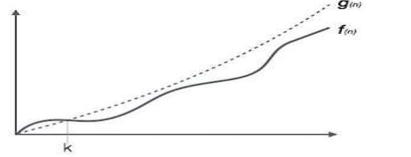
Big Oh notation (O)
Big Oh notation (O):-Upper bound.
Asymptotic \less than. (slower rate)
Let f (n) and g (n) differentiable function F (n) grows with the same rate or slower than g (n)
Example: let f (n) =3n+2 and g (n) =n2 show f (n) =O (n2)
F (n) =2n2+3n+4 and g (n) =2n2+3n2+4n2 show f (n) =O (n2).
The formula is:-f (n) ≤cg (n), n ≥no, no≥1 and c>0; c is a constant

Slide 53
Big Oh notation (O)
Example:Question-1: f(n)=10n+5 and g(n)=n. Show that f(n) is O(g(n)). To show that f(n) is O(g(n)), we must show that there exist constants c and k such that f(n)<=c.g(n) for all n>=k. 10n+5<=c.n ==> for all n>=k
let c=15, then show that 10n+5<=15n 5<=5n or 1<=n So,
f(n)=10n+5<=15.g(n) for all n>=1 (c=15, k=1),
there exist two constants that satisfy the above constraints.
Question-2: f(n)=3n²+4n+1. Show that f(n)=O(n²). 4n<=4n² for all n>=1 and 1<=n² for all n>=1 3n²+4n+1<=3n²+4n²+n² for all n>=1 <=8n² for all n>=1
So, we have shown that f(n)<=8n2 for all n>=1.
Therefore, f(n) is O(n2), (c=8, k=1), there exist two constants that satisfy the constraints.

Slide 54
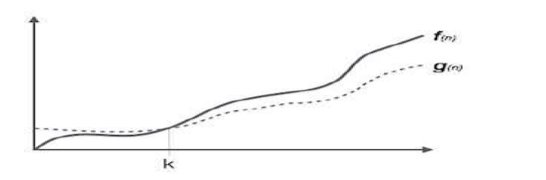
Omega notation (Ω )
Omega notation (Ω ):-Lower bund.
Asymptotic :greater than(faster rate)
Let f (n) and g (n) differentiable function F (n) grows with the same rate or faster than g (n)
Example: let f (n) =3n2+2 and g (n) =n2 show f (n) =Ω (n2)
The formula is:-f (n) ≥cg (n), n ≥no, no≥1 and c>0; c is a constant .
Example: Find g(n) such that f(n) = Ω(g(n)) for f(n)=3n+5 g(n) = √n, c=1, k=1. f(n)=3n+5=Ω(√n)

Slide 55
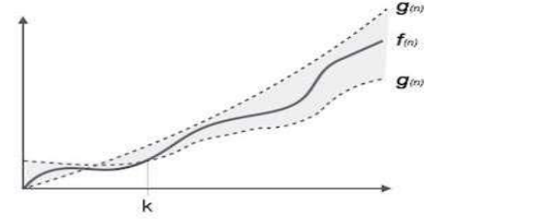
Theta notation (θ)
Asymptotic ―equality‖ (same rate)
The formula is:-c1g (n) ≤f (n) ≤c2g (n), n ≥no, no≥1 and c>0; c is a constant
Finding Asymptotic Complexity: Examples
Let f (n) =2n2+3n+4; g (n) =n2
1n2≤2n2+3n+4≤9n2=f (n) = θ (n2)
Let f (n) =1n2+logn+n2+nlogn+n+≤10n2logn=f (n) =n2logn= θ (n2logn). Example: Find g(n) such that f(n) = Θ(g(n)) for f(n)=2n²+3 ==> n² ≤ 2n² ≤ 3n² ==> c1=1, c2=3 and no=1 ==>f(n) = Θ(g(n)). Theta Notation (Θ-Notation) (Optimal bound)

Slide 56
Asymptotic Notation
if f(n) is O(g(n)) this means that f(n) grows asymptotically no faster than g(n).
if f(n) is Ω(g(n)) this means that f(n) grows asymptotically no slower than g(n).
if f(n) is Θ(g(n)) this means that f(n) grows asymptotically at the same rate as g(n)

Slide 57
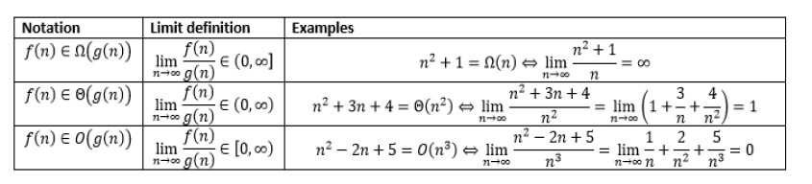
Asymptotic Notation using limit

Slide 58
Rules to Estimate Big Oh
Pick the highest order. Ignore the coefficient. Example: T(n)=3n + 5 ==> O(n) T(n)=3n²+4n+2 ==> O(n²)
Rule 1: If T1(n)=O(f(n)) and T2(n)=O(g(n)), then T1(n)+T2(n)=max(O(f(n)),O(g(n))), T1(n)*T2(n)=O(f(n)*g(n))
Rule 2: If T(n) is a polynomial of degree k, then T(n)=θ(n^{k}).
Rule 3: log^{k} n=O(n) for any constant k. This tells us that logarithms grow very slowly.

Slide 59
Rules to Estimate Big Oh
T(n) | Complexity Category functions F(n) | Big-O
c, c is constant | 1 | C=O(1)
10logn + 5 | logn | T(n)=O(logn)
√n +2 | √n | T(n)=O(√n)
5n+3 | n | T(n)=O(n)
3nlogn+5n+2 | nlogn | T(n)=O(nlogn)
10n² +nlogn+1 | n² | T(n)=O(n²)
5n³ + 2n² + 5 | n³ | T(n)=O(n³)
2^{n}+n⁵+n+1 | 2^{n} | T(n)=O(2^{n})
7n!+2^{n}+n²+1 | n! | T(n)=O(n!)
8n^{n}+2^{n} +n² +3 | n^{n} | T(n)=O(n^{n})

Slide 60
Thank you
Question???

